Slide 1


E-commerce Sentiment Analysis
Automating Feedback Intelligence with NLP

Slide 2

The Challenge
Manual review of thousands of comments is slow, expensive, and inconsistent. We need speed to save customer satisfaction.

Slide 3

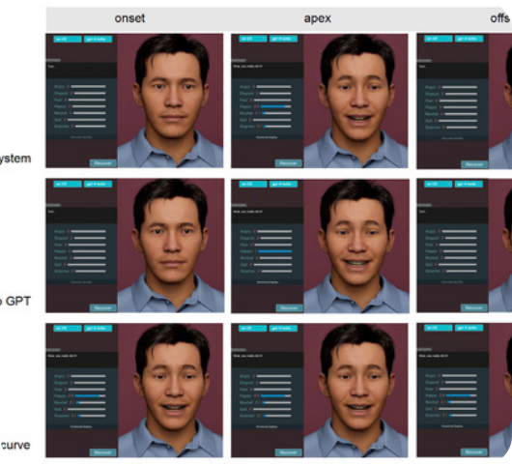


Automation Pipeline
Using Python and Natural Language Processing (NLP), we built a pipeline to ingest raw e-commerce reviews and output actionable data.
1. Data Ingestion
Reading massive .xlsx datasets with 8,000+ entries.
2. Sentiment Mapping
Algorithmic segregation into Positive & Negative labels.

Slide 4
Analysis Scale
8,005
Massive Scale Efficiency
The Python script processed this entire dataset in less than 5 seconds, identifying critical sentiments that would take a human team days to read.
TOTAL COMMENTS ANALYZED

Slide 5
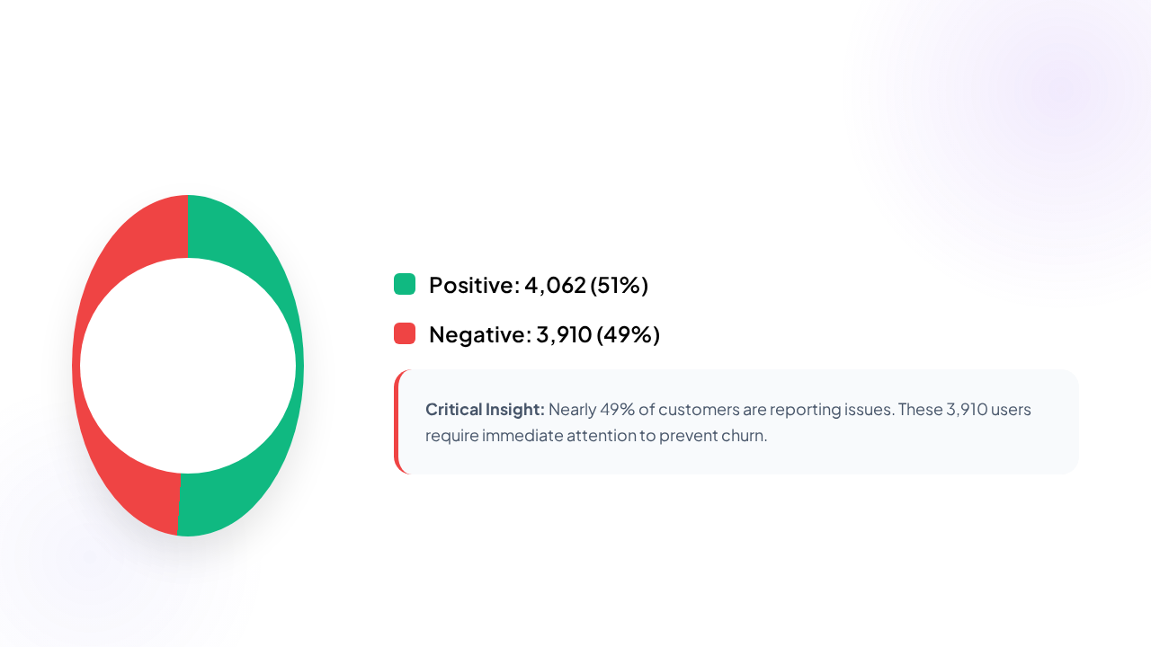
Sentiment Distribution

Slide 6







Project Deliverables
NLP Model
Critical List
Master Data
Python script `nlp_model.py` for automated daily sentiment tracking.
Isolated list of 3,910 negative comments for immediate service recovery.
Cleaned CSV dataset ready for Tableau & PowerBI Dashboarding.

Slide 7

Questions?
E-commerce Sentiment Analysis Complete
DATA SCIENCE | PROJECT M2

